Slide 1
Modelling Rotating Black Holes
Joseph Sweeney – Supervised by Kasper Peeters

Slide 2
Introduction
 | Charge | No Charge
Spin | Kerr-Newman | Kerr
No Spin | Reissner-Nordström | Schwarzschild

Slide 3

Kerr Metric
The Event Horizon
The Ergoregion

Slide 4
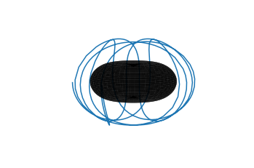
Modelling Photon Orbits

Slide 5
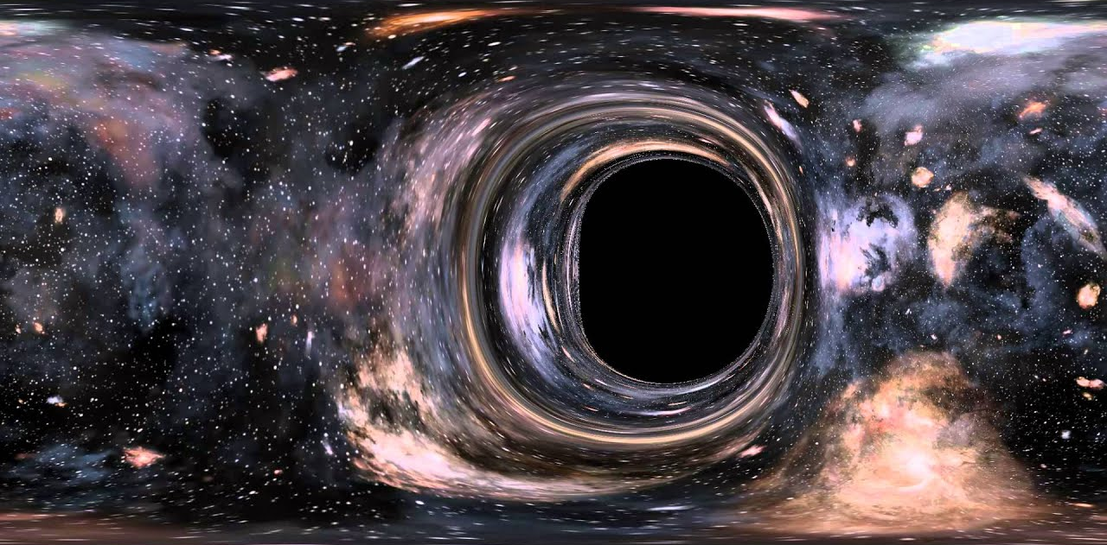
Imaging the shadow
https://www.youtube.com/watch?v=qg7OP0uFJ8U&ab_channel=VadymKoliada

Slide 6
Future Work
Add accretion discs
Account for gravitational redshift
Deal more appropriately with the ergoregion

